Slide 1
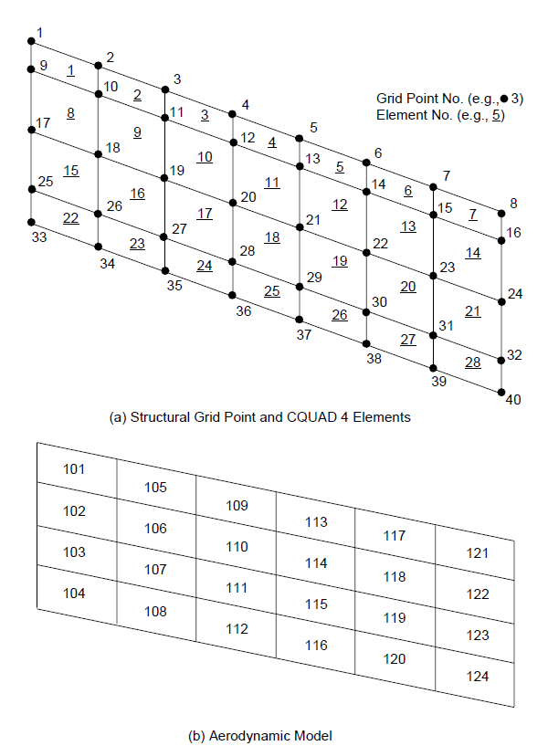

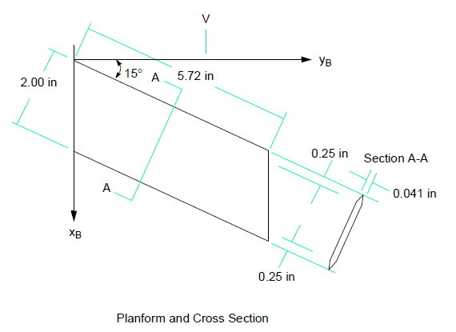
Chord = 2.07055 in
Semi-Span=5.5251 in
Mach # = 0.45
Material = Al

Slide 2
NASTRAN Aero Example HA144C
Admir Makas

Slide 3
Introduction
Example problem HA144C from MCS Nastran Aeroelasticity Manual.
Example problem based on wind tunnel experiments carried out on a 15 degree back swept aluminum wing.
A single trim condition is considered at Mach 0.45.
Solution is obtained using Doublet-Lattice method.
Stability derivatives are calculated and tabulated for comparison.

Slide 4
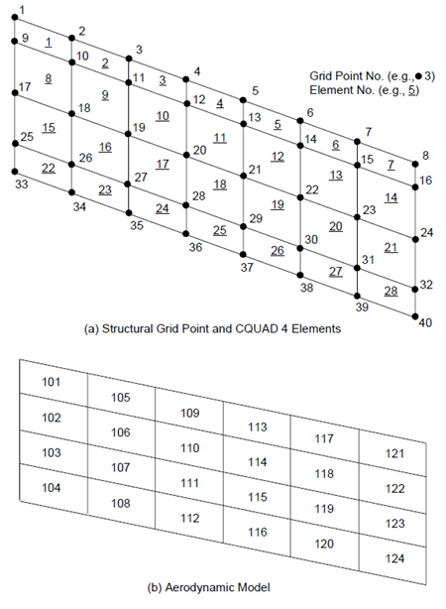
Model Details
Chord = 2.07055 in
Semi-Span=5.5251 in
Wing geometry
Structural Model:
40 nodes
28 CQUAD4 elements
2 RBAR elements (nodes 17-9 and 17-25)
Aerodynamic Model:
24 aerodynamic boxes

Slide 5
Material Properties
Trim Condition
Isotropic material (Al):
E = 10.3x10^6 psi
G = 3.9x10^6 psi
ρ = 0.100 lb/in^3
Shell properties (WING):
Thickness = 0.041 in
Thickness tapers down to 0 on leading and trailing edges.
Mass of wing included in analysis using card GRAV.
TRIM 1 (Subsonic)
MACH = 0.45
Flight Dynamic Pressure (q) = 2 psi
Angle of Attack = 0.0 deg
Pitch rate = 0.0
Downwash
Wing is fixed at 10 deg angle of attach. This value is assigned to all aerodynamic boxes using user matrix input W2GJ. In this case it will be a 1 by 24 vector.

Slide 6
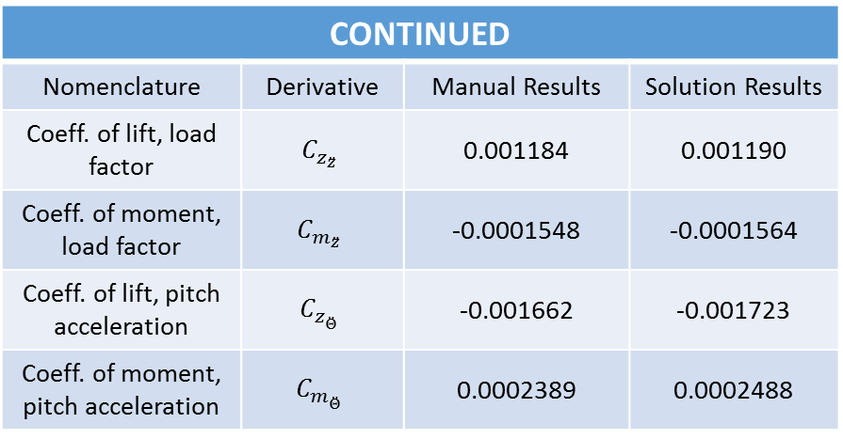
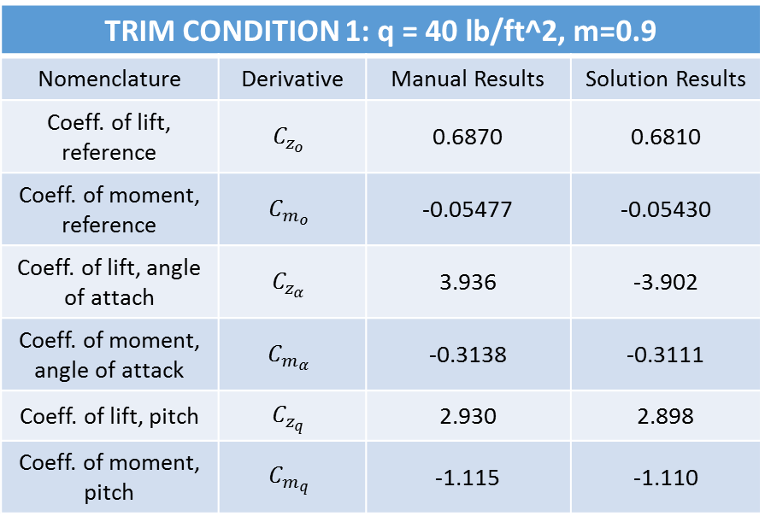
Results
Stability derivatives are tabulated below.
TRIM CONDITION 1: q = 40 lb/ft^2, m=0.9
Nomenclature | Derivative | Manual Results | Solution Results
Coeff. of lift, reference | $$C_{z_{o}}$$ | 0.6870 | 0.6810
Coeff. of moment, reference | $$C_{m_{o}}$$ | -0.05477 | -0.05430
Coeff. of lift, angle of attach | $$C_{z_{α}}$$ | 3.936 | -3.902
Coeff. of moment, angle of attack | $$C_{m_{α}}$$ | -0.3138 | -0.3111
Coeff. of lift, pitch | $$C_{z_{q}}$$ | 2.930 | 2.898
Coeff. of moment, pitch | $$C_{m_{q}}$$ | -1.115 | -1.110
CONTINUED
Nomenclature | Derivative | Manual Results | Solution Results
Coeff. of lift, load factor | $$C_{z_{\ddot{z}}}$$ | 0.001184 | 0.001190
Coeff. of moment, load factor | $$C_{m_{\ddot{z}}}$$ | -0.0001548 | -0.0001564
Coeff. of lift, pitch acceleration | $$C_{z_{\ddot{Θ}}}$$ | -0.001662 | -0.001723
Coeff. of moment, pitch acceleration | $$C_{m_{\ddot{Θ}}}$$ | 0.0002389 | 0.0002488

